Slide 1


Migration
US Migration Trends

Slide 2
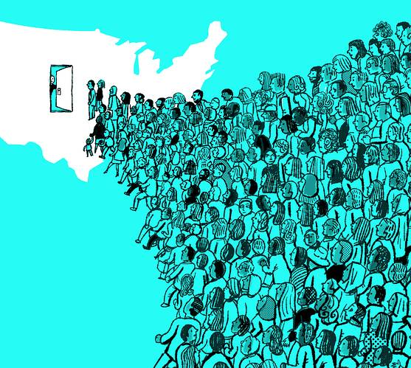
United States Migration Trends
Trends in migration flows to the United States over the past two-and-a-half decades.
Migrant profiles
Who
Age
Gender
Class
Country of Origin
Why
Economic Gain
Forced migration
Other(____________)
Statistical Analysis
Graphs
Analysis

Slide 3

A Brief History
## Here is where we can talk about US migration past present feature. It’s relevance today in politics ect. Ect. We can also discuss why we’ve decided to work with it’s data.

Slide 4
A Brief History
There is no relationship between income, violence and immigrations flows

Slide 5



Hypothesis
Here is where we can discuss our projected outcomes

Slide 6
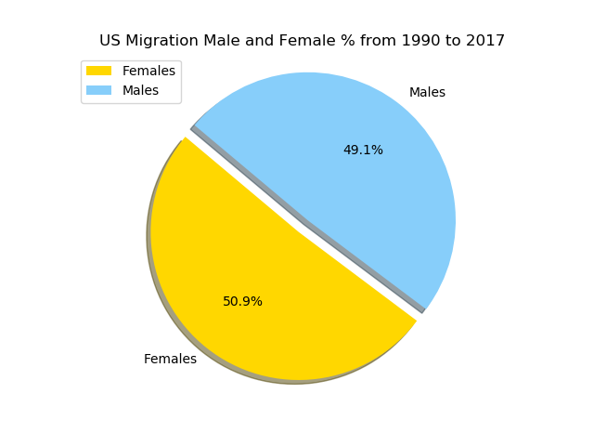
Hypothesis
Here is where we can discuss our projected outcomes

Slide 8
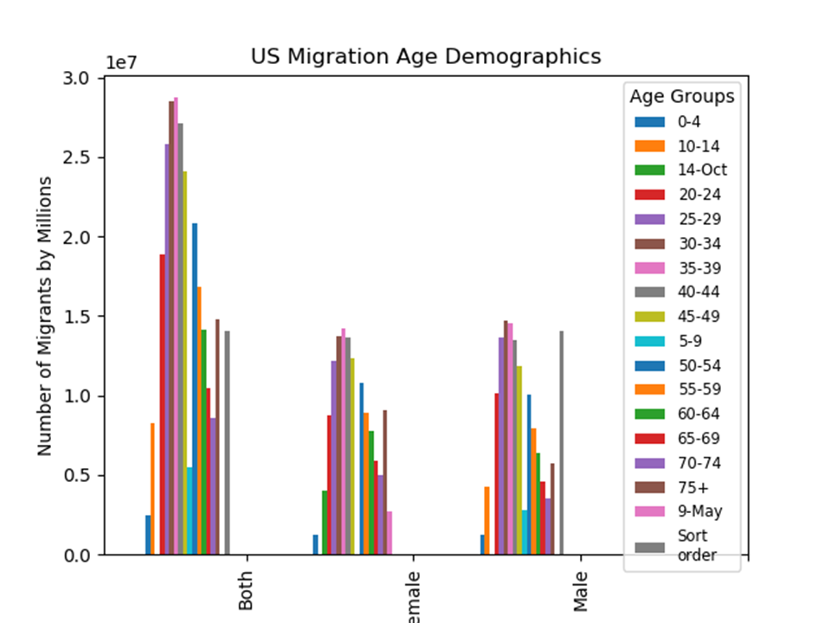

Slide 9
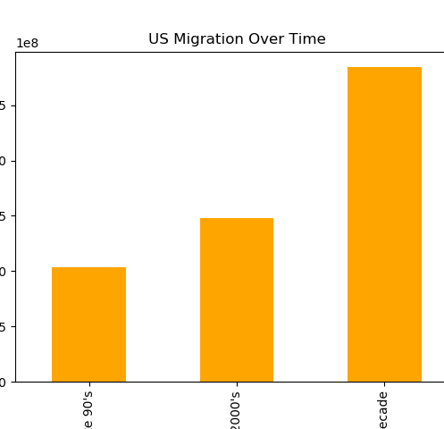
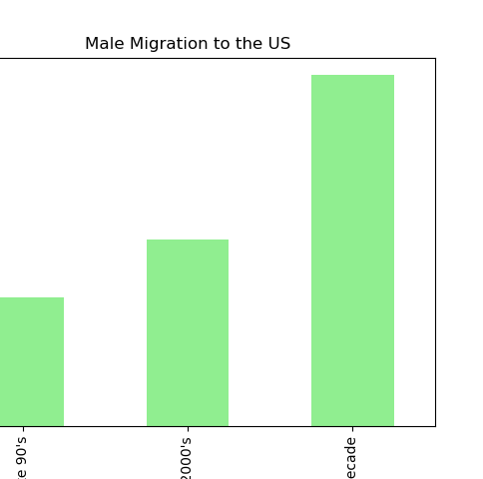
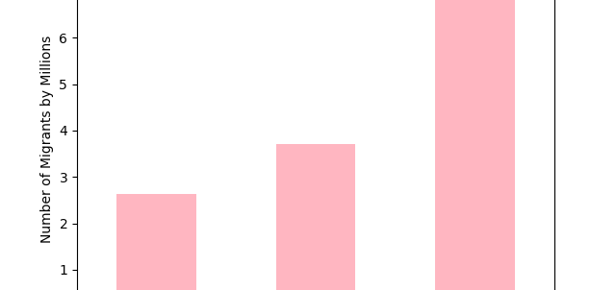

Slide 10
